Slide 1

FIFA Data Science Project
Omer Norman
Yarin Rahamim
Website Project Link: https://bestxififaanalysisproject.000webhostapp.com/

Slide 2

Introduction
Our project will revolve around the football world – in the FIFA yearly squad. We wanted to take a world of data that we are interested in, and we went through a process to find the right research questions that intrigued us while we could learn something new from it with the tools we acquired in this course.

Slide 3

FIFA Yearly Squad
Every year FIFA organization choses their best 11 players of the year. It combines ceremony and big luxury and everyone in the football world want to be part of it.

Slide 4

Research Questions
What is the chance of players in the top 5 Europe leagues to be chosen to FIFA yearly squad?
What is the age with the biggest chance to be chosen?

Slide 5

Data web
We got our data from:
https://data.world
https://sofifa.com
https://www.wikipedia.org
The libraries we used:
Pandas, NumPy, seaborn, matplot, pylab, sklearn, PIL

Slide 6

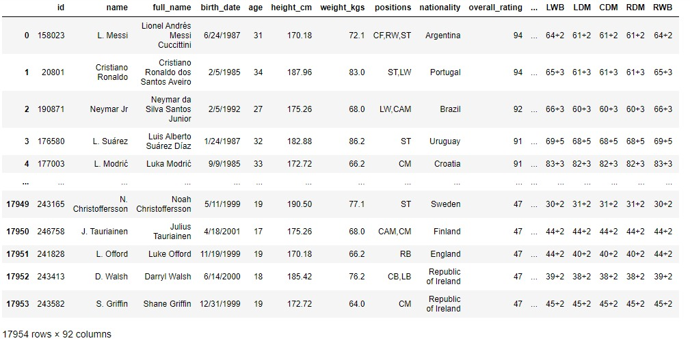
Our Data include 17954 rows × 92 columns Data Table:

Slide 7
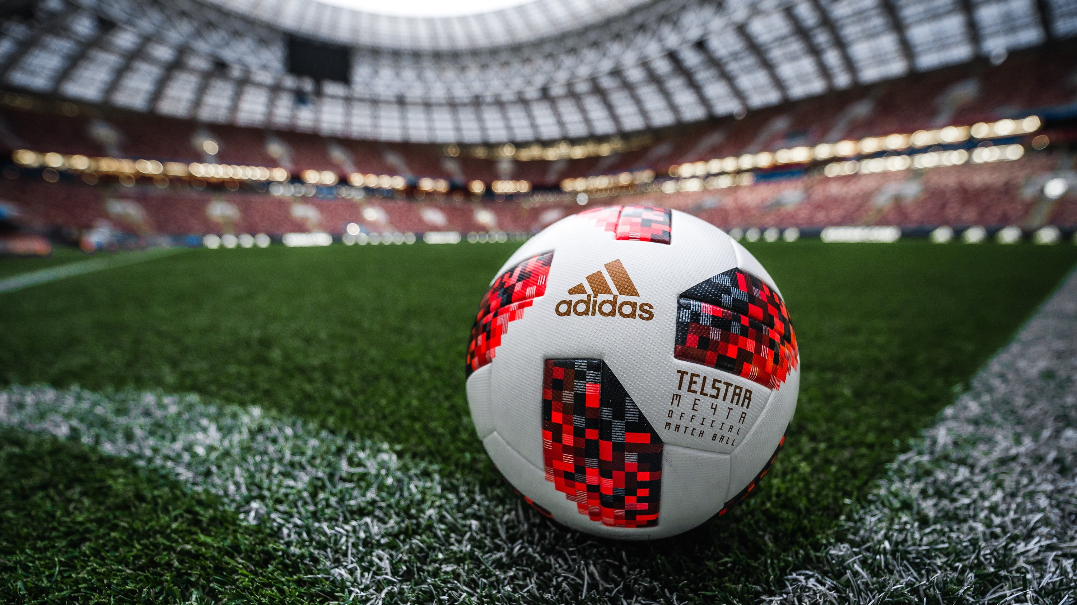

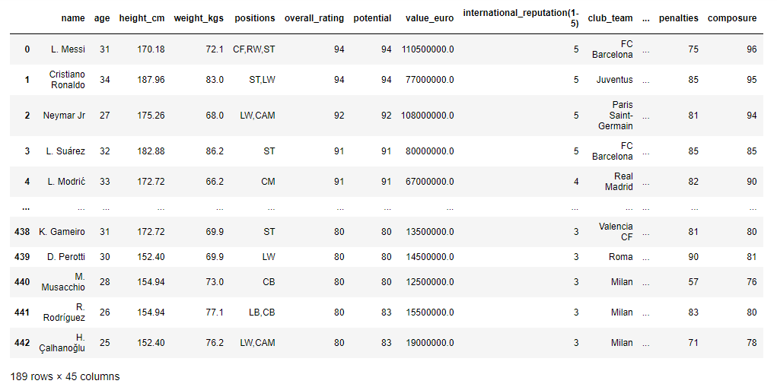
How did we handle the data?
Checked duplicates.
Removed columns that are not necessary.
Removed the players who play in Leagues with low level.
Reputation (under 3).
Removed the players who play in clubs with under 80 Rating (scale of clubs rating: 54-86).
Removed the players under 80 Rating (scale of players rating: 48-94).
Added 'Predicted Rating' column to data frame.

Slide 8
Research Question #1
What is the chance of players in the top 5 Europe leagues to be chosen to FIFA yearly squad?

Slide 9
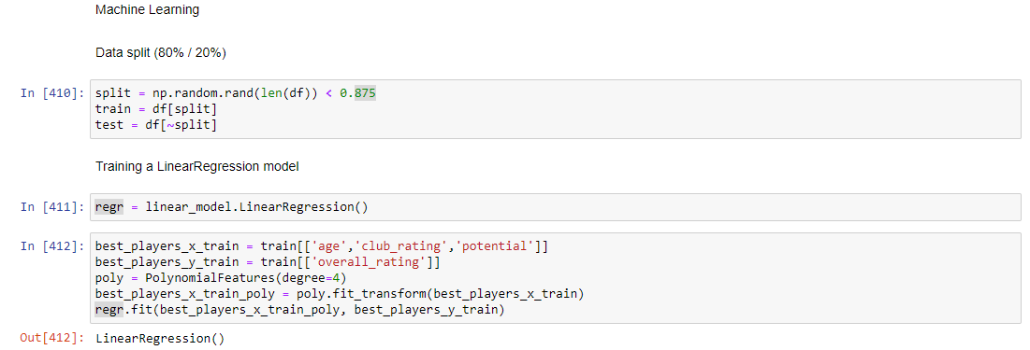
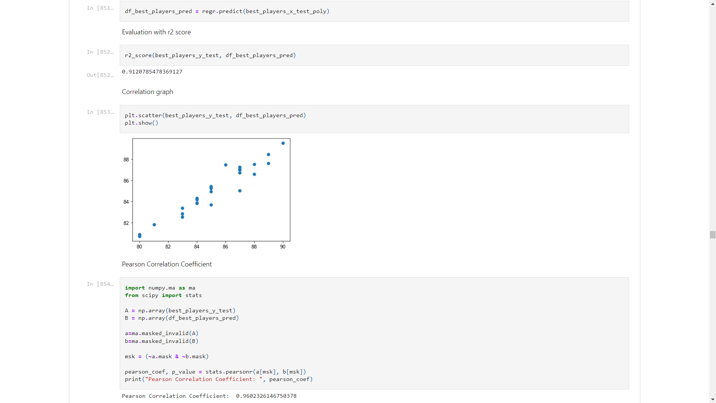
Machine Learning - Linear Regression
Prediction – r2 score, Correlation graph and Pearson Correlation Coefficient
Split our data to train and test

Slide 10
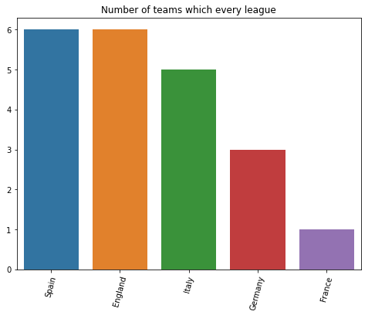

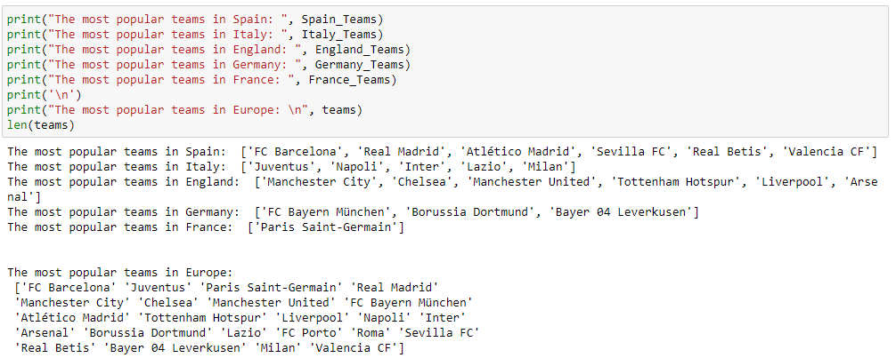
Top 5 Leagues In Europe

Slide 11
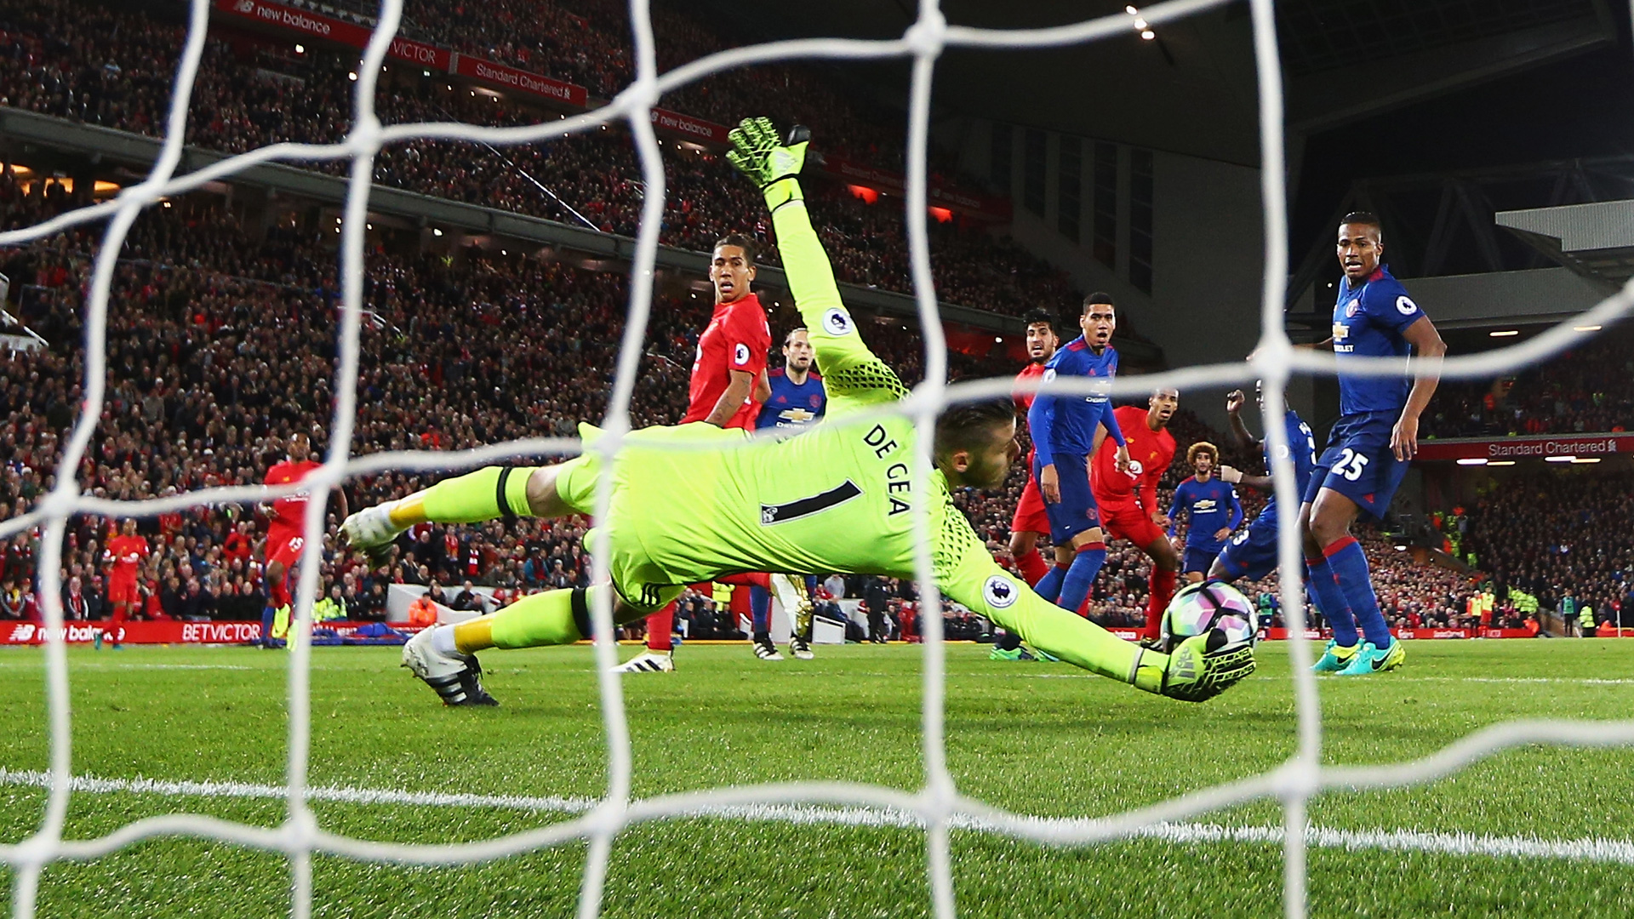
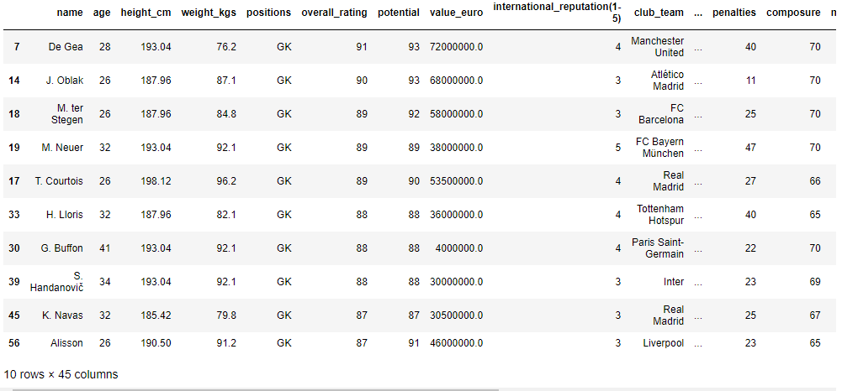
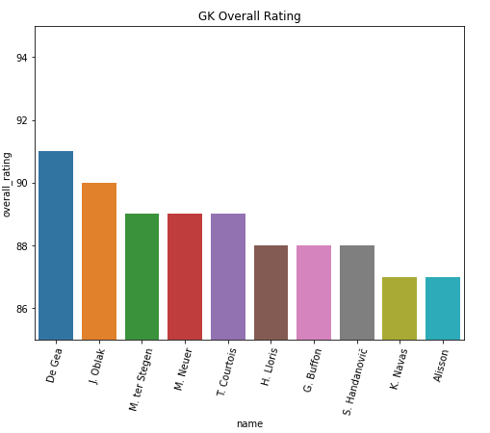
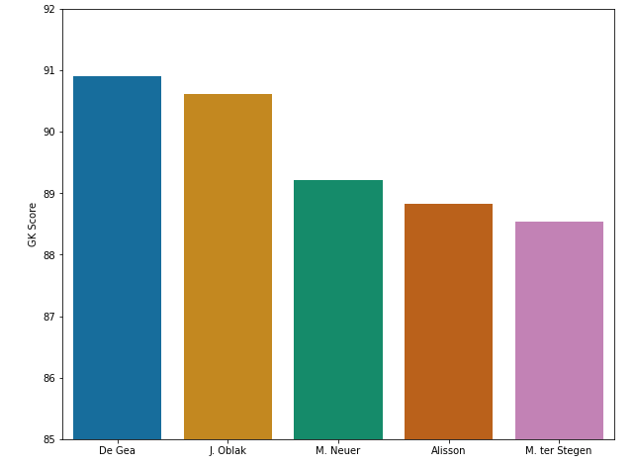
Goalkeepers
Before Prediction
After Prediction

Slide 12
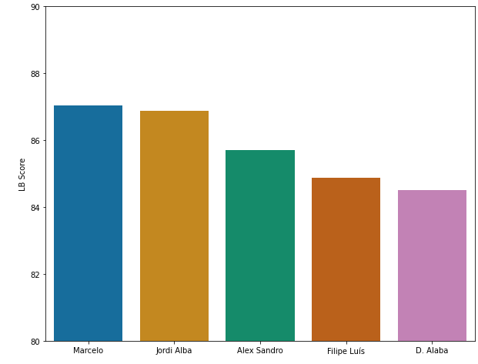
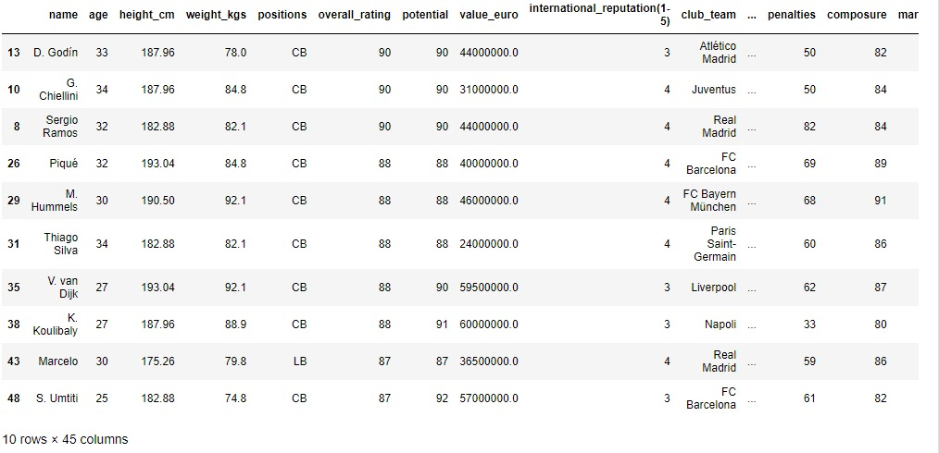
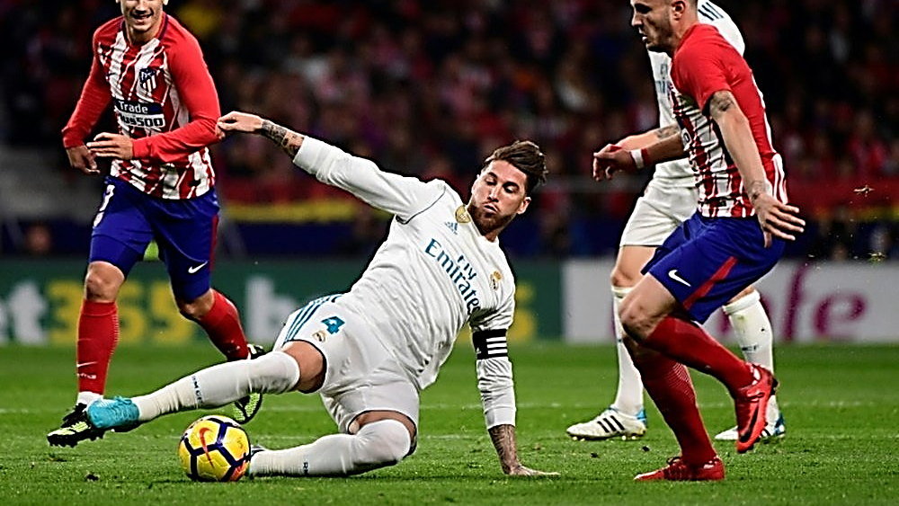
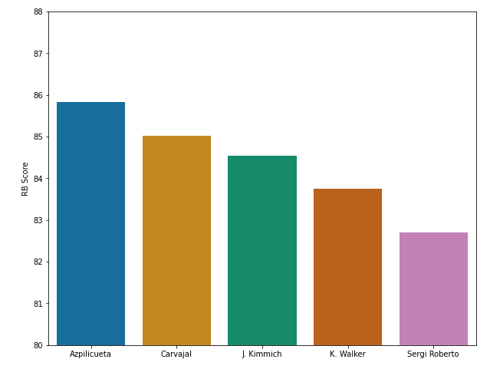
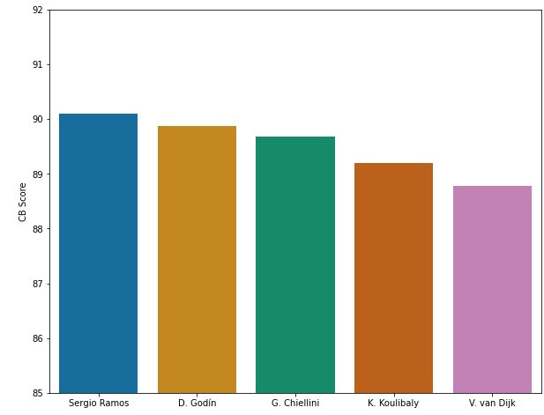
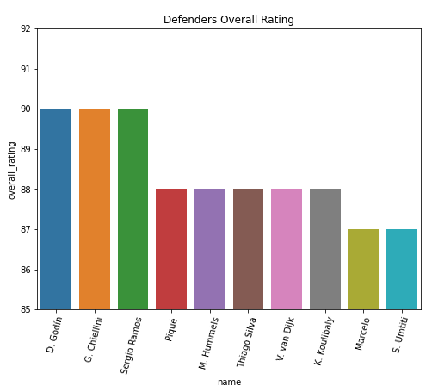
Defenders
Before Prediction
After Prediction

Slide 13
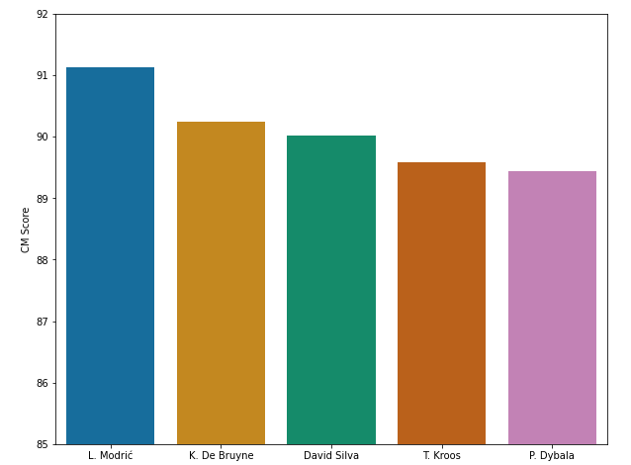
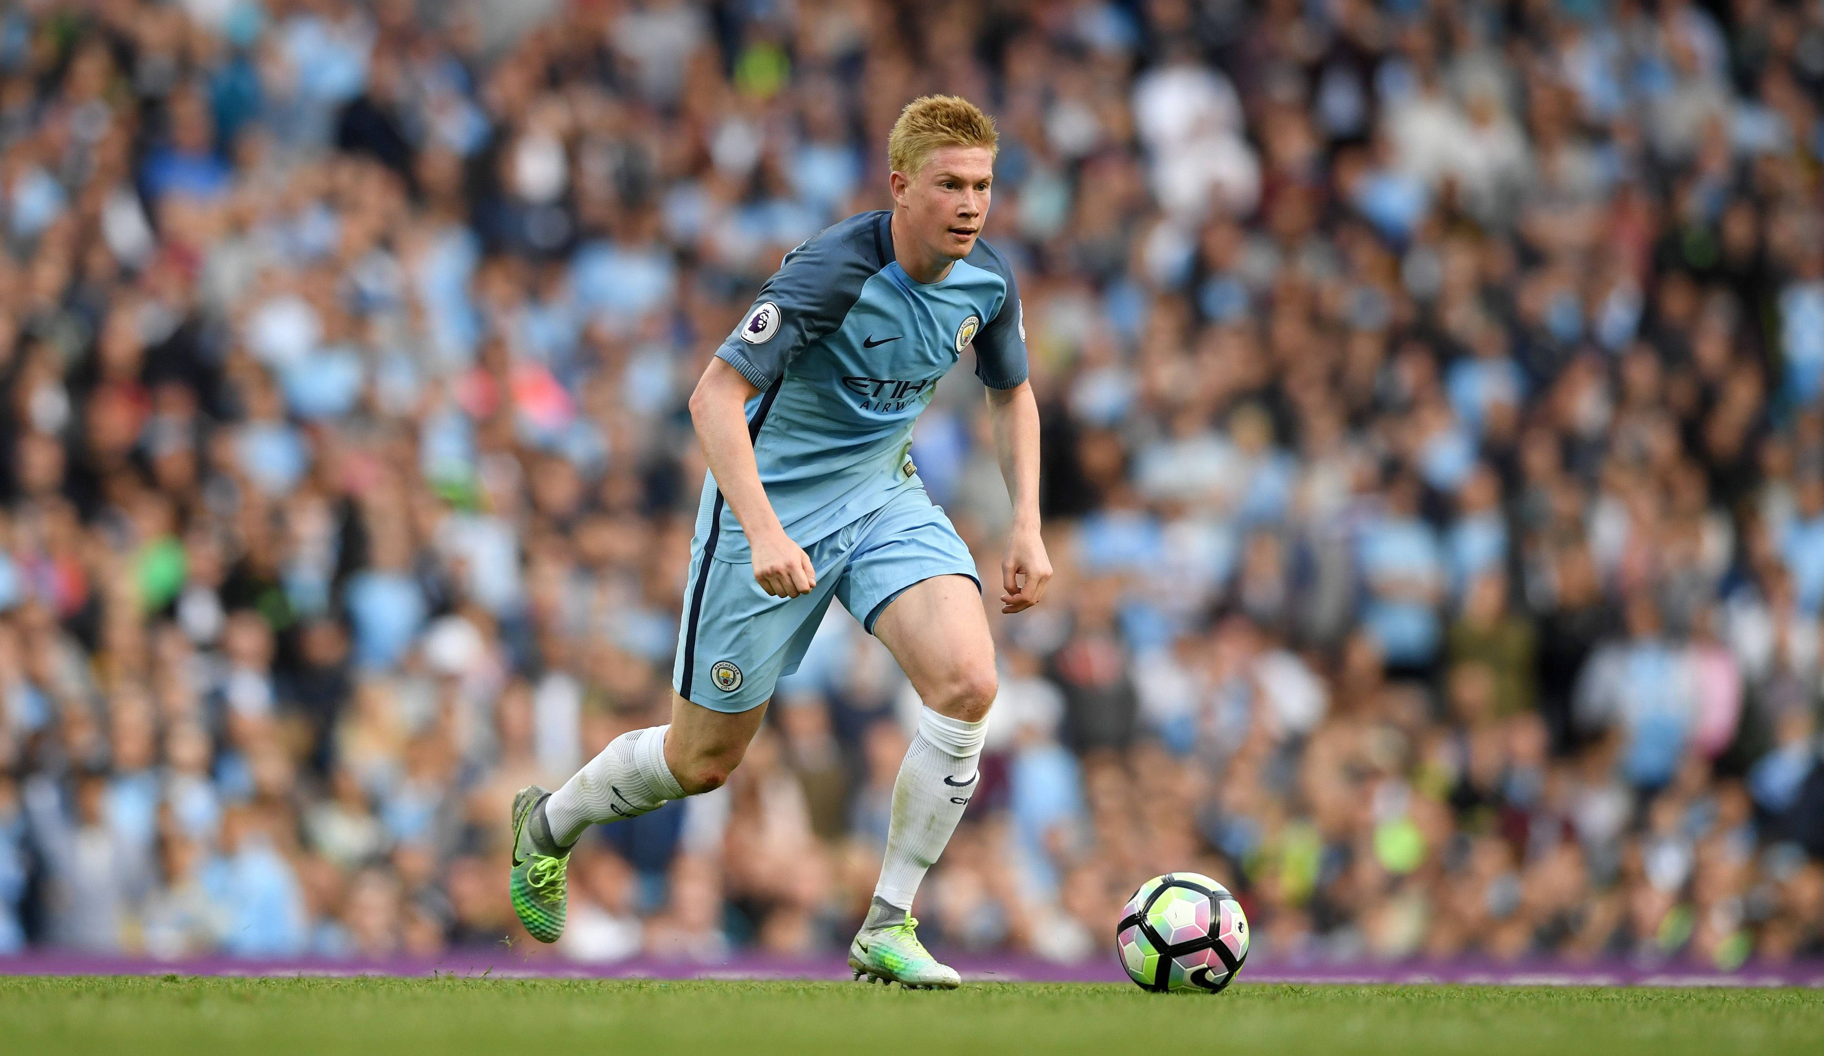
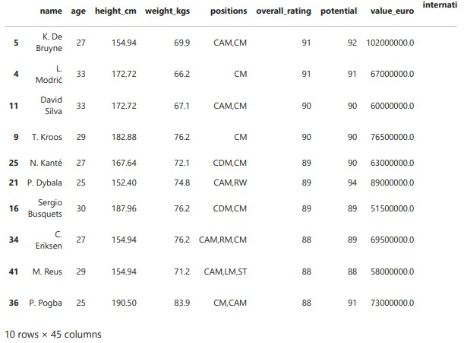
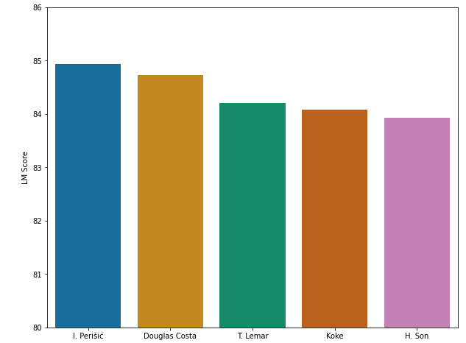
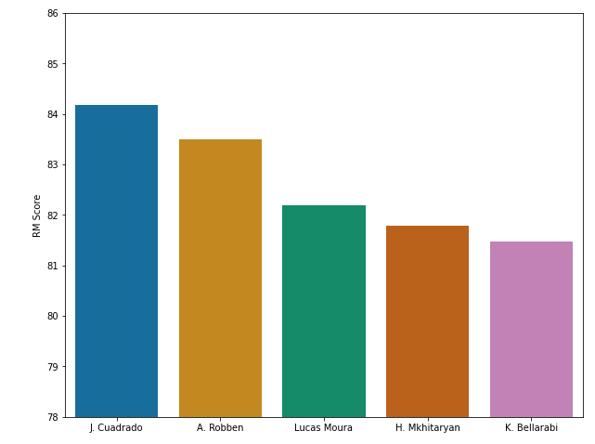
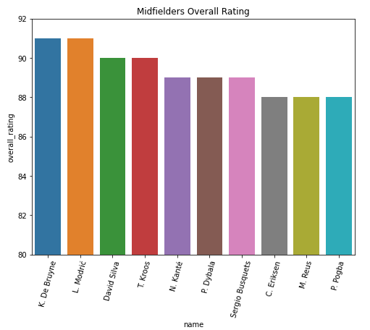
Midfielders
Before Prediction
After Prediction

Slide 14
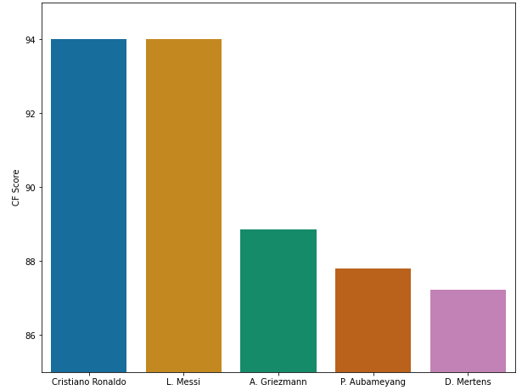

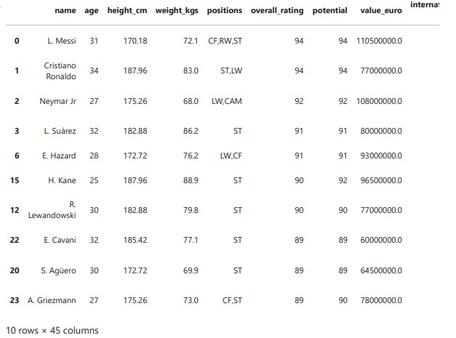
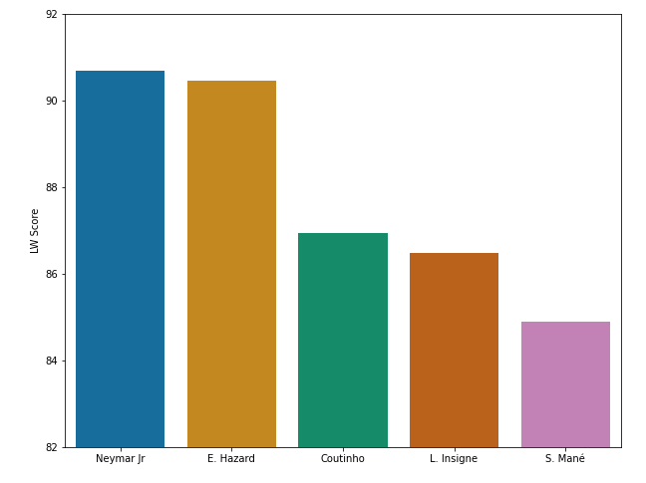
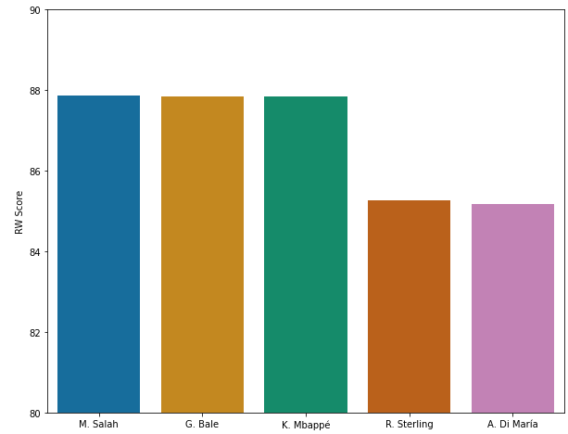
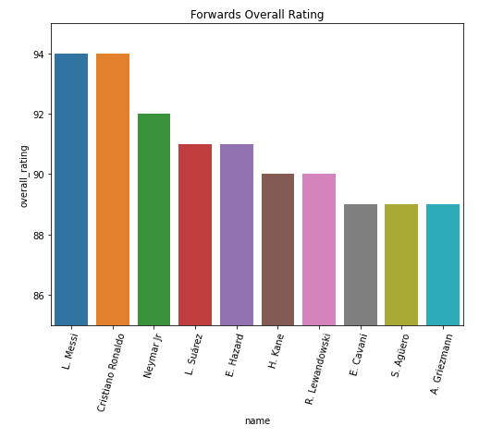
Forwards
Before Prediction
After Prediction

Slide 15
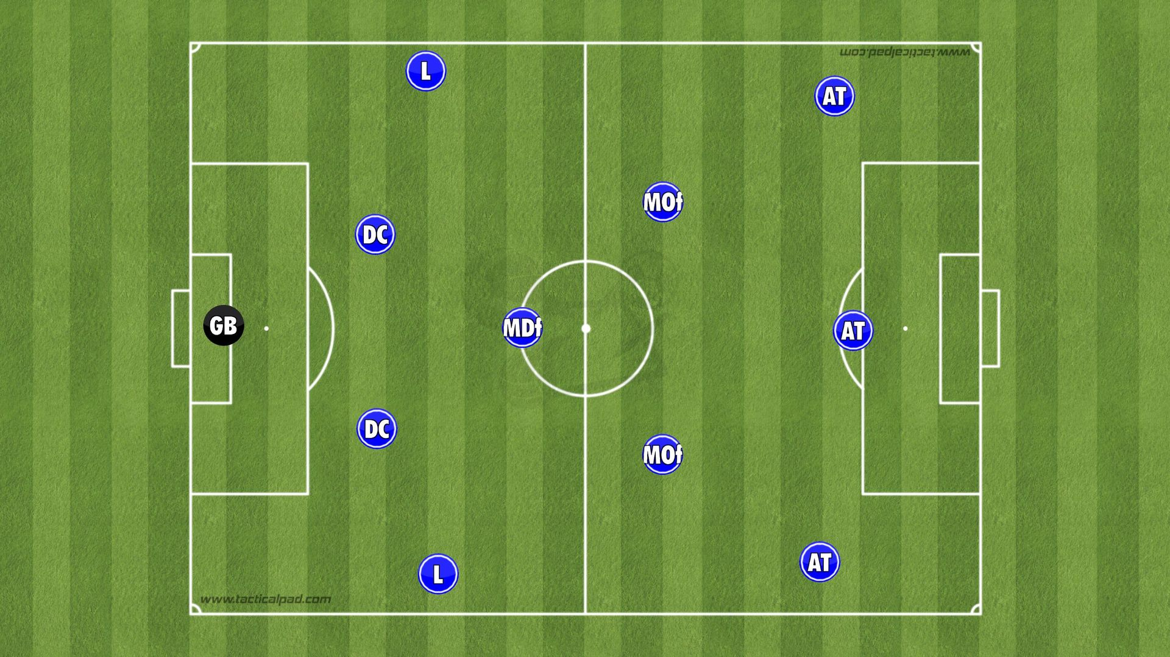
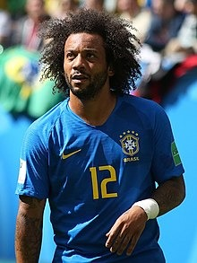
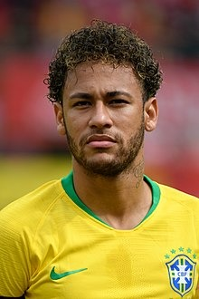
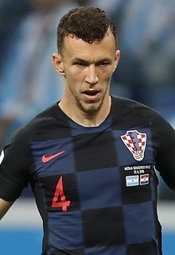
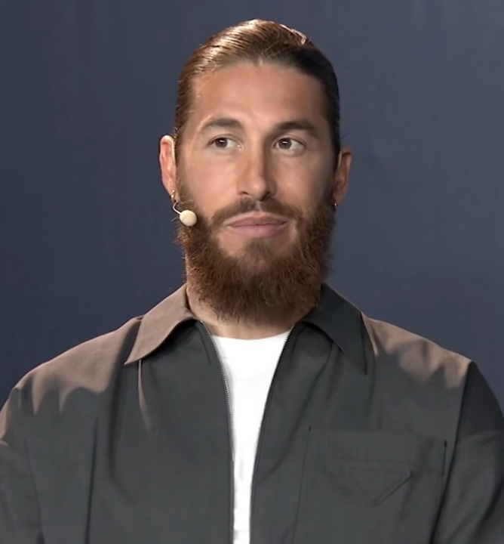
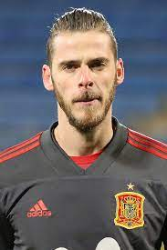

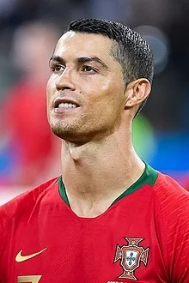
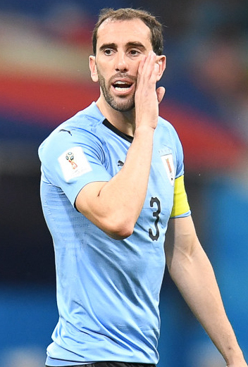
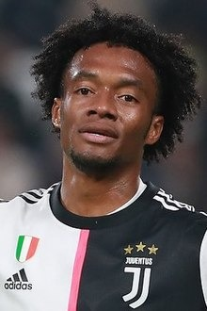
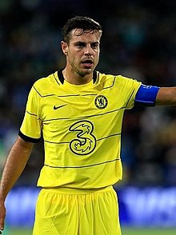
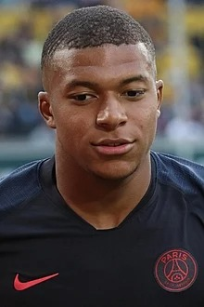
Best XI
After Prediction

Slide 16
Research Question #2
What is the age with the biggest chance to be chosen ?

Slide 17
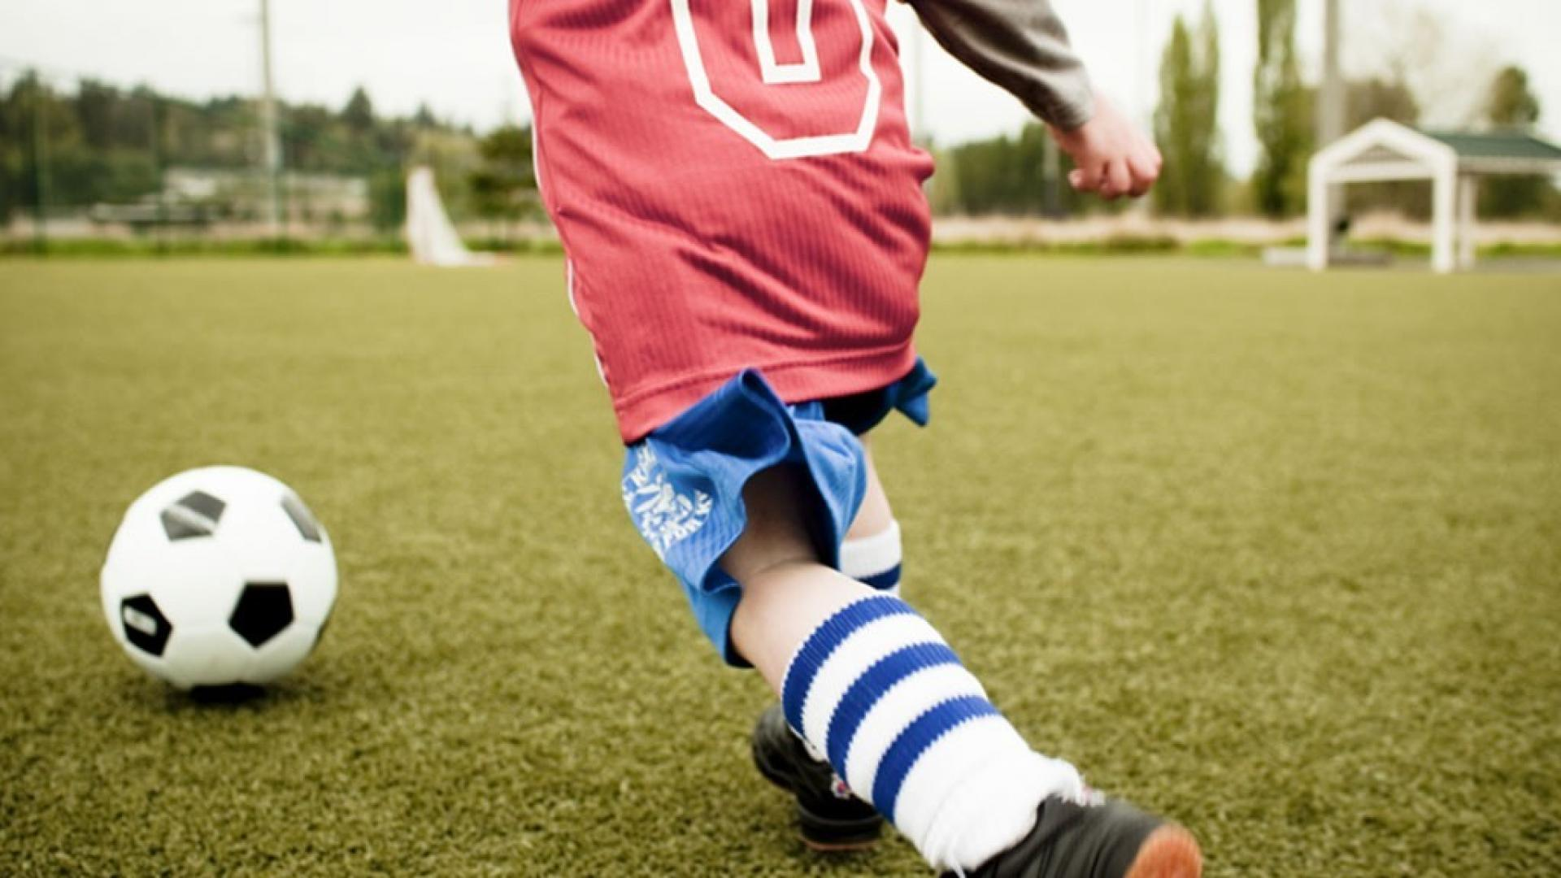
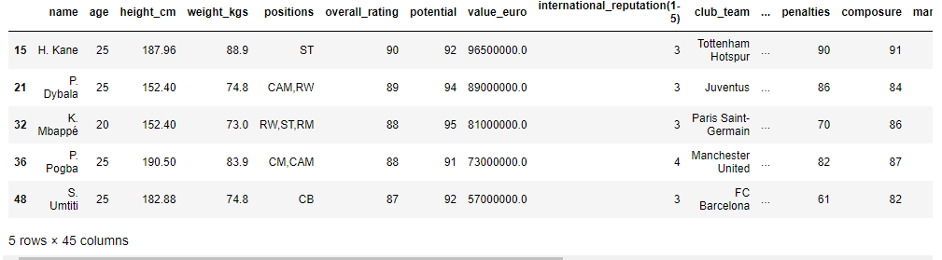
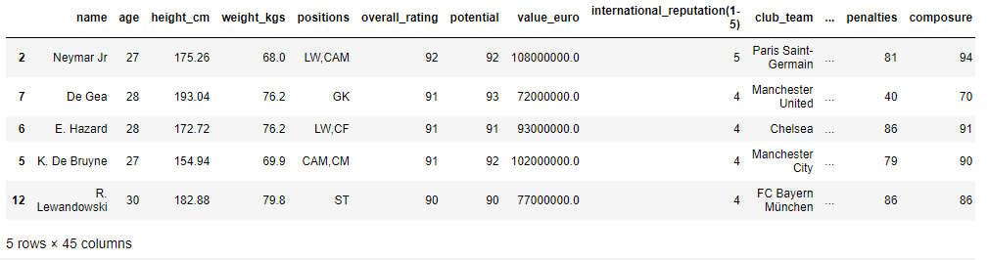
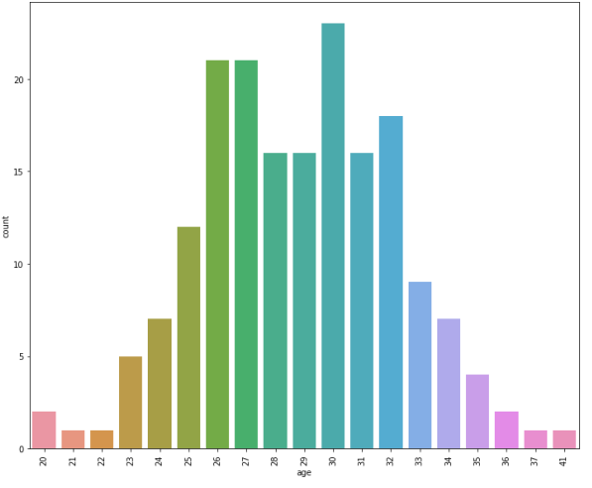
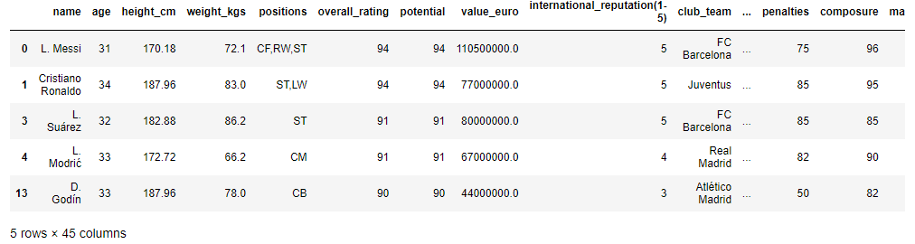
20 – 25
26 – 30
Split Ages Before Prediction
31 – 36

Slide 18
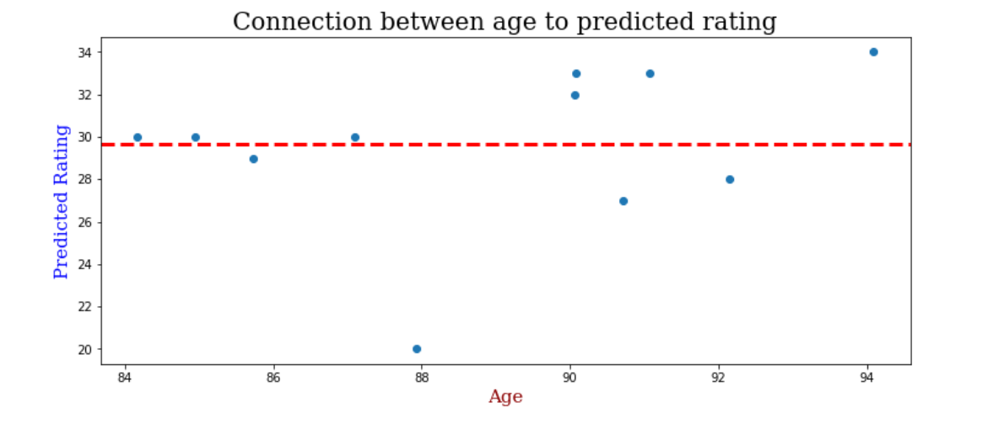
Split & Average age of best XI after prediction
The average of the best in FIFA squad is: 29.45

Slide 19
Conclusion
In our project we compared between top 5 leagues players in Europe, at the end we got the best 11 players considering their personality data. Also we got the avg age of this players and it showed us which age has the best chance to be part of the team.

Slide 20
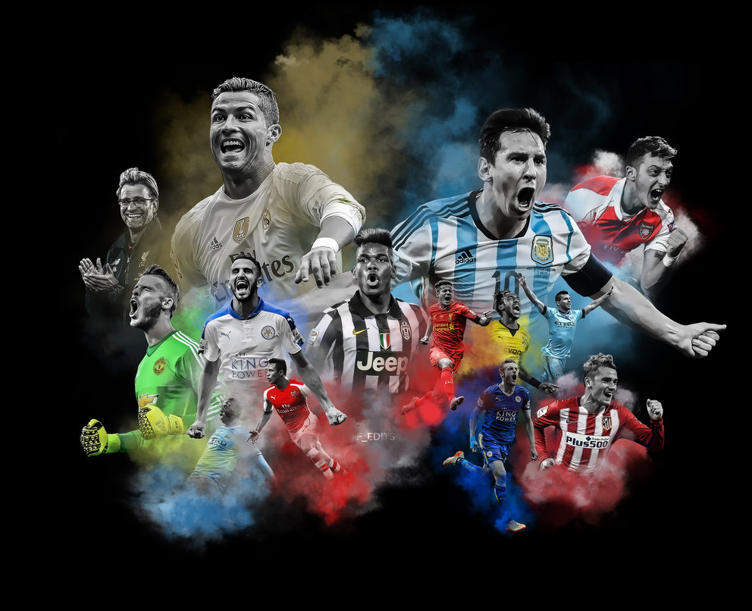
Thank You !
Omer Norman & Yarin Rahamim

